Slide 1


Payroll Overview
3/26/2021

Slide 2
Agenda
Role
Expectations
Intro to Payroll
Payroll Today
Payroll’s Future

Slide 3

Payroll Engineering Team Charter
Keep Payroll running and meeting the business needs
Continuously improve performance, capacity and availability
Keep Payroll secure
Build the next generation Payroll system

Slide 4
SW Engineering Manager Role Overview
Hire and onboard a strong Payroll team in India
Manage the delivery of change and the workload assigned to the India Payroll team
Act as a coach and technical mentor to the engineering team
Ensure standards are maintained and processes are followed
Help refine and drive the architecture of the next generation of Payroll
Contribute to the Payroll vision and roadmap

Slide 5
Payroll Major Initiatives
Ongoing small enhancements/bug fixes
Timecard Performance
Payroll Services Migration and SOA Architecture
India Team build out
RHEL8 upgrade (Prod and Non-prod)
Residuals Consolidation
Move Payroll to the Cloud
DB Cross Year Consolidation - Phase 1
KPIs, Logging, Monitoring and Alerting (Kibana and New Relic)
Delivery process improvements
Azure for Devops
Kafka for Payroll

Slide 6
Into to Payroll

Slide 7
Cast and Crew Payroll
Introduction to Payroll
Overview
Basic Payroll Flow
Sub-systems
Payroll Today
Technology Stack
Current Payroll Stack
7 Cast & Crew Payroll Env
Production Environment
Servers
Server Sizes
Integration
Security Highlights
Security Connectivity
PII and Data Masking
Backups
Disaster Recovery
Payroll’s Future
Current AWS Status
Current Major Initiatives
Payroll Evolution
High Availability
New Data Model
Q&A

Slide 8
Payroll Overview
Payroll is a Cast and Crew internally developed system that processes timecards from gross to net, calculates withholdings, taxes, garnishments, pension, etc.
The Payroll system also creates, and processes invoices, prints checks, sends banks direct deposits and collects setup information such as clients, unions, employees, contracts, dealmemos, projects and rates.
The Payroll system provides reporting for Clients, finance, taxes, workers compensation, pensions and Payroll Operations.

Slide 9
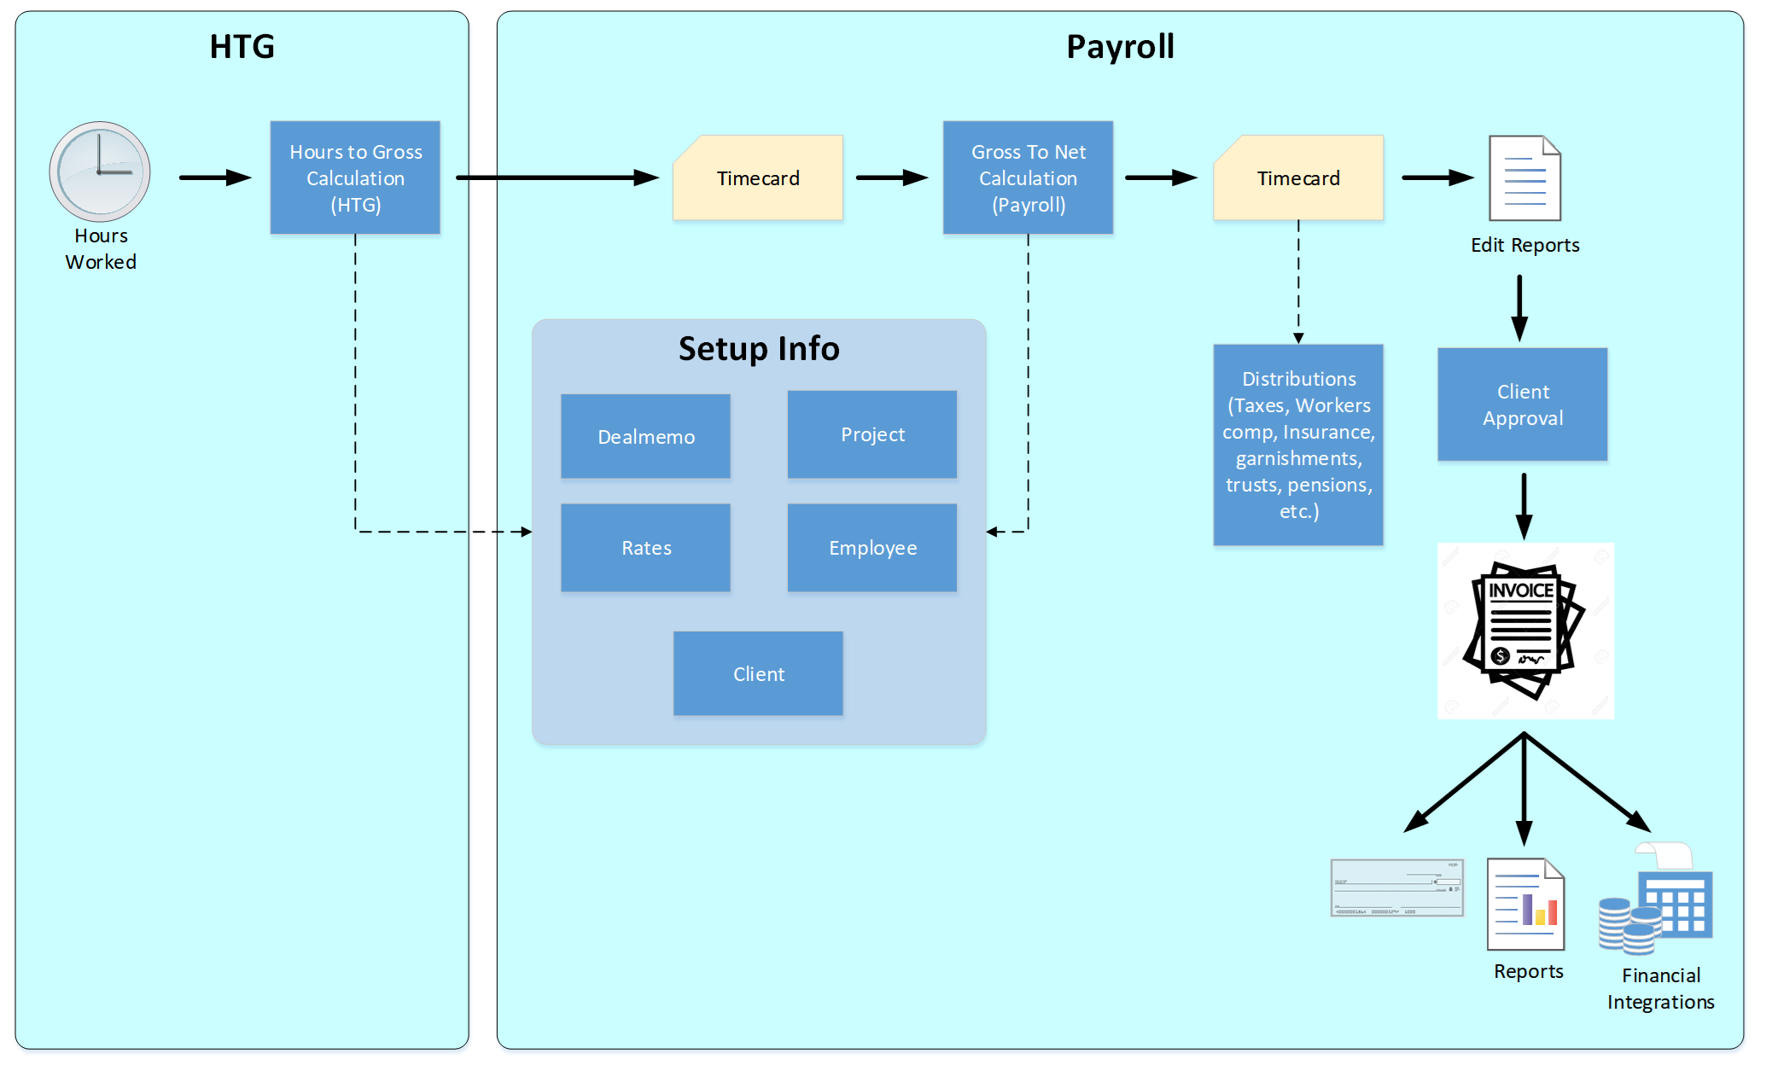
Payroll Happy Path

Slide 10
Payroll Subsystems

Slide 11
Current
State

Slide 12
Payroll Technology Stack
Technology | Current | Moving to
Language | C/Ruby/Perl | C#/.net core
OS | Linux RHEL6 | Linux RHEL8
Database | Oracle 12c | Oracle 19c
Source Control | RCS | GitHub
CI/CD | Cruise (internal) | Cruise, Asure for Devops
Monitoring | Sensu, PagerDuty, OEM, ELK, Munin, log monitoring | New Relic
UI | Terminal/SSH, Java | Web
Environment | On Premise/VMWare | AWS

Slide 13
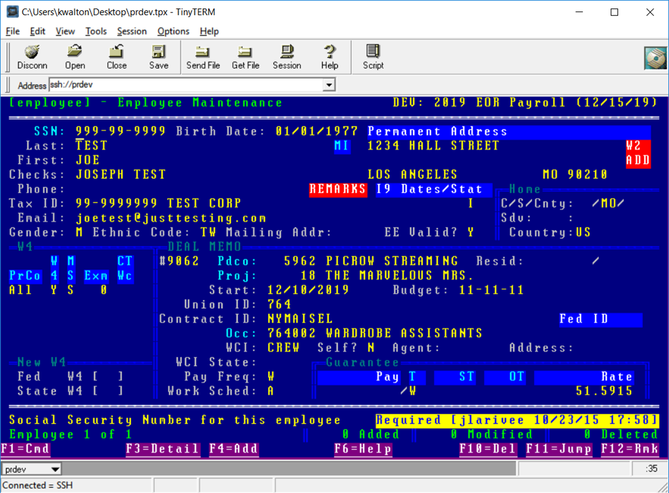
Current Basic Payroll Stack

Slide 14
7 C&C Production Payroll Environments
We have the following instances, all using the same applications and database schemas:
US Employer of Record (EOR)
US Paying Agent
Canada Vancouver – Canadian dollars
Canada Vancouver – US dollars
Canada Toronto – Canadian dollars
Canada Toronto – US dollars

Slide 15
Payroll Production Environment

Slide 16
Payroll Database Consolidation Approach
Current
CDB1 – PA21 and 20, Canada 21 and 20
CDB3 – Pay21, Pay20
Future
CDB1 – Pay21 and Pay20, PA21 and 20, Canada 21 and 20

Slide 17
Payroll Servers

Slide 18
Payroll Servers Sizes

Slide 19
Payroll Integration with other C&C Products

Slide 20
Payroll Security Highlights
The C&C Payroll Environments are not accessible to the outside except for 2 Client specific and secure portals
Access to all Payroll environments is monitored and reviewed quarterly
Payroll QA Engineers act as the release managers for Payroll. Software Engineers do not have access to release code
Payroll Software Engineers do not have access to production unless requested, approved by IT management/Security and it is tracked. Access is only for 24 hours
Though data is copied from production to non-production environments either daily or weekly, all PII data is masked in the non-production environments

Slide 21
Payroll Security Connectivity

Slide 22
PII and Data Masking - Data Flow

Slide 23
Payroll Backups
Database Servers
Pptpcdb1
Fulls: Tue, Fri starting 11pm
Incrementals: Sunday, Monday, Wed, Thu, Sat starting 11pm
Ppdwcdb1
Fulls: Fridays starting at 11pm
Incrementals: M, T, W, T, S, S starting at 11pm
Application servers
Fulls: Saturdays starting at 12:30 am
Incrementals: S, M, T, W, T, F starting at 12:30am

Slide 24
Payroll Disaster Recovery
Production environment is replicated to Las Vegas
Use Oracle DataGuard and log shipping every 15 minutes
RTO: 6 hours
RPO: 15 minutes
DR Tested annually

Slide 25
Payroll Current AWS Status
TDB

Slide 26
Future
State

Slide 27
Major Non-Functional Initiatives (12-18 months)
Implement a new yearend process
Consolidate Payroll transactional databases
Implement load balancing of the payroll services over multiple web services servers
Build a Highly Available Payroll Environment
Improve logging, monitoring and alerting. Implementing New Relic
Continuously move Payroll reporting to the Datahub
Move all Payroll environments to AWS
Enabling Kafka as a method of consuming Payroll web service
Move from Oracle 12c to 19c
Modernize the Payroll CI/CD Pipeline
Move future development from C/Ruby to C#
New Payroll Data Model
Move the nightly refreshed Payroll data warehouse to a near real time replicated copy consumed by the C&C Datahub
Move Payroll from an application to a payroll processing engine driven by web services in the cloud

Slide 28
Payroll Evolution
End Goal: Highly available, web service driven payroll processing engine running in the cloud

Slide 29
High Availability
Maintain 24x7 availability for products that rely on Payroll (HTG, Hours+, Ontime, Start+, MyCnC and C&C Studio)
Ensure Payroll is highly available across:
Services
Database
Applications
Storage
Causes of downtime (in order of occurrence)
Patching and maintenance
Data changes and repairs
System changes (CPU/Memory/Storage)
Yearend
Unplanned downtime
Re-configures and migrations
Application release

Slide 30
New Payroll Data Model
Move master data to central repository separate from the transactional data
Rearchitect for:
Performance
Normalization
Better change management
Using the database processing capabilities
Take advantage of database partitioning
Consolidate across years
Consolidate across by locale

Slide 31

Q&A

Slide 32
End

